Slide 1
Capstone Engagement
Assessment, Analysis, and Hardening of a Vulnerable System

Slide 2
Table of Contents
This document contains the following sections:
01
Network Topology
02
Red Team: Security Assessment
03
Blue Team: Log Analysis and Attack Characterization
Hardening: Proposed Alarms and Mitigation Strategies
04

Slide 3
Network Topology
‹#›

Slide 4
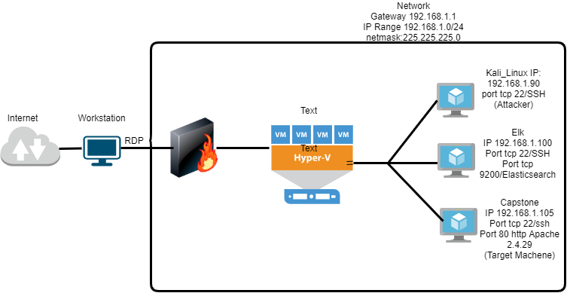
Network Topology
Network
Address Range:192.168.1.0/24
Netmask:225.225.225.0
Gateway:192.168.1.1
Machines
IPv4:192.168.1.1
OS:Windows
Hostname:Gateway /ML-RefVM-684427
IPv4:192.168.1.90
OS:Linux
Hostname: Kali
IPv4:192.168.1.100
OS:Linux
Hostname:ELK
IPv4:192.168.1.105
OS:Linux
Hostname:Capstone

Slide 5

Red Team
Security Assessment
‹#›

Slide 6
Recon: Describing the Target
Nmap identified the following hosts on the network:
Hostname | IP Address | Role on Network
Gateway /ML-RefVM-684427 | 192.168.1.1 | Gateway It allows internal connections between internal systems on the network
Kali | 192.168.1.90 | Attacker Machine This system is used to launch remote attack to the target machine which is Capstone
ELK | 192.168.1.100 | Network security Monitoring )NSM/ Log Analysis
Capstone | 192.168.1.105 | Webserver / Target Machine This system has Apache webserver running on it and is used to exploit the vulnerability.

Slide 7
Vulnerability Assessment
The assessment uncovered the following critical vulnerabilities in the target:
Vulnerability | Description | Impact
Sensitive Data Exposure (SDE) | SDE allows access for the public into the classified folders contain sensitive information intended for authorised users. | An attacker can Brute_force credentials required for accessing secret folder and get sensitive information using which he can further break into the web server
Security Misconfiguration | Inadequate security controls for the server or web application. What a company thought of as a safe environment actually has dangerous gaps or mistakes that leave the organization open to risk such as weak passwords. | Red team could easily brute force into the server and crack the passwords of the users.
Remote code execution via command injection | Due to unauthorized file upload vulnerability,attacker can upload arbitrary shell scripts and achieve remote code execution on the web server | Using this vulnerability,an attacker can open reverse shell to the server

Slide 8
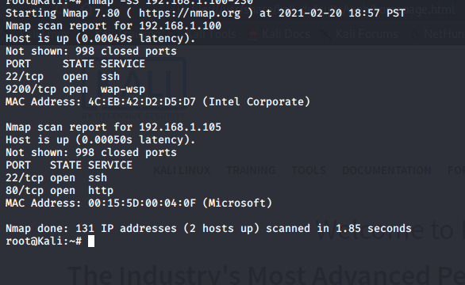
Exploitation: [Sensitive Data Exposure (SDE)]
01
02
03
Tool & Processes
Nmap- To scan network
Browser_To navigate to the explore
Hydra- To perform Brute force attack against secret folder and get password for user ashton
Achievements
Nmap scan revealed that capstone web server accessible via port 80
Navigate to webserver url IP using browser highlighted secret folder on the server which is password protected but susceptible to brute force
Got password for user Ashton by running Hydra attack against secret directory

Slide 9
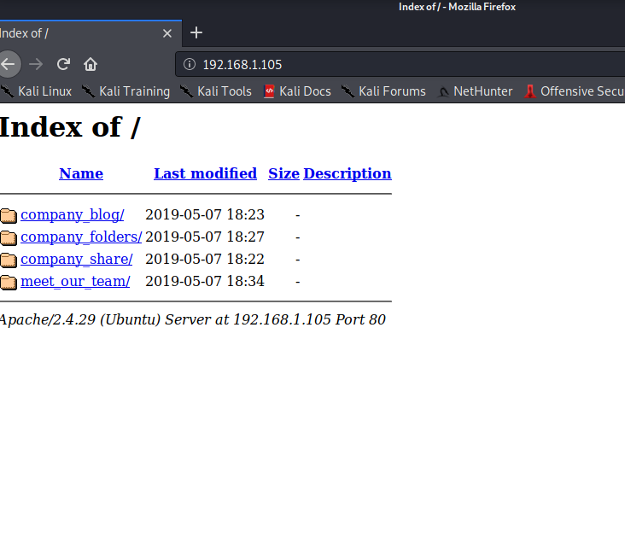
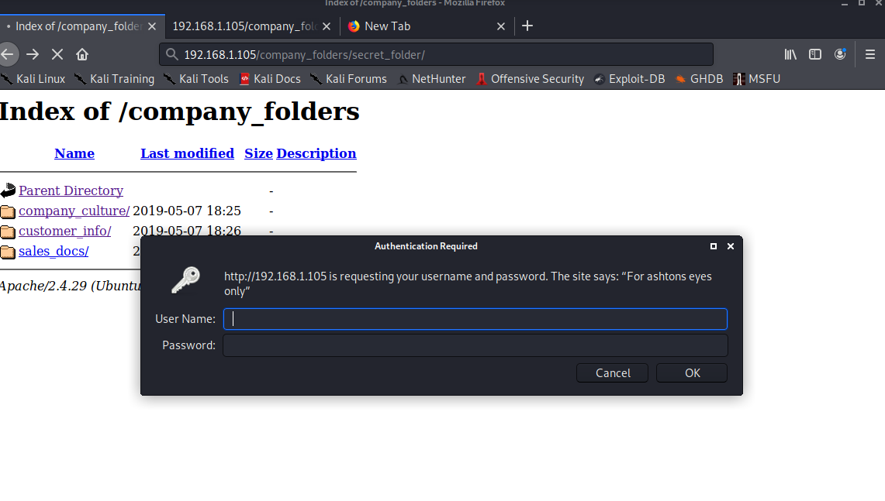
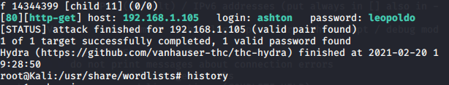

Slide 10
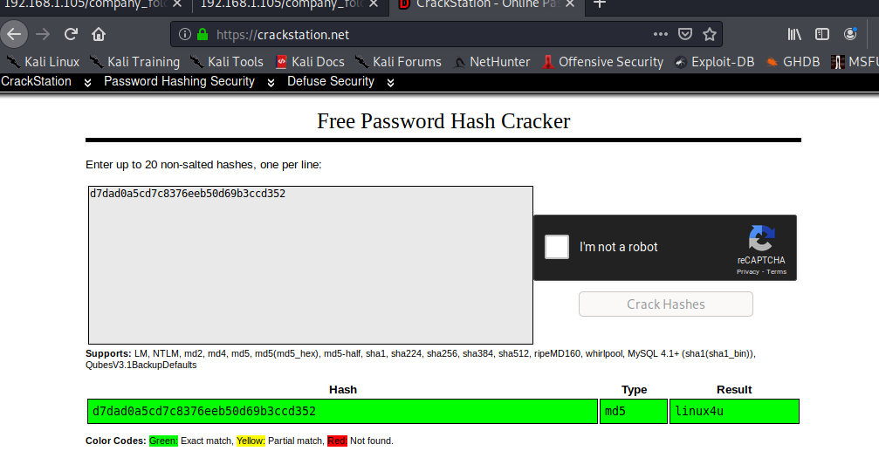
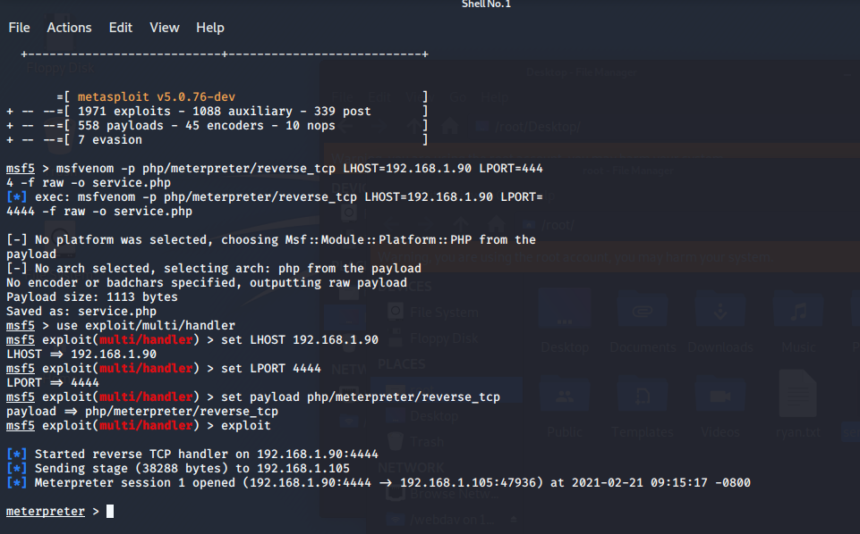
Exploitation: [Security Misconfiguration]
01
02
03
Tools & Processes
Crackstation- To break the password hash
Msfvenom- to create a customer payload to open a reverse shell to attacker
Upload shell via WebDAV
Achievements
Logged into WebDAV server using stolen credentials and uploaded payloaded into the
(Client.php) into the share folders

Slide 11
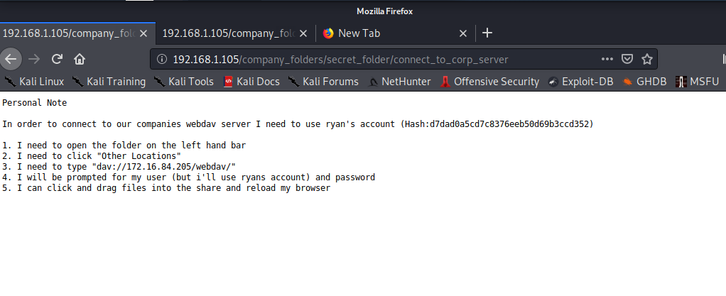
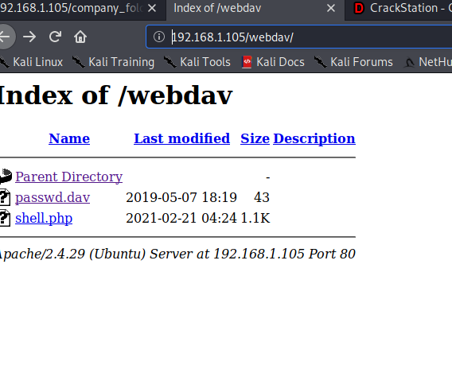
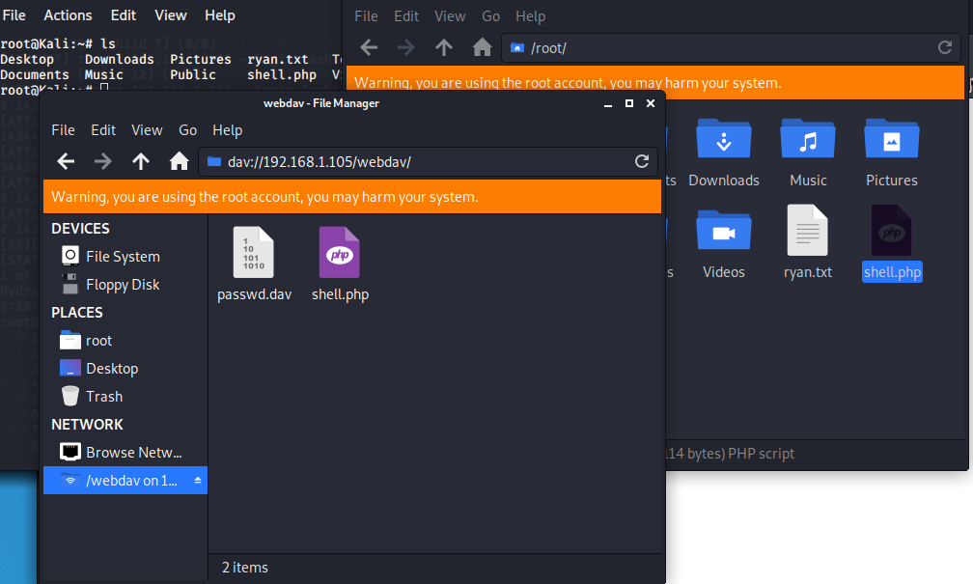
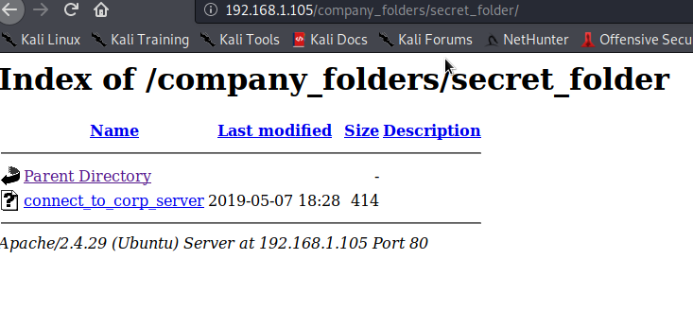
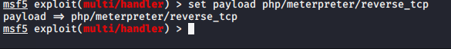

Slide 12
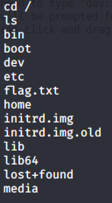
Exploitation: [Remote code execution (RCE) via command injection ]
01
02
03
Tools & Processes
Metasploit -To open meterpreter session to connect to target system once the uploaded payload is executed
Achievements
Leveraging RCE allows us to open a meterpreter shell to the target
Achieving a shell on the target allows us to view all file and capture the flag

Slide 13
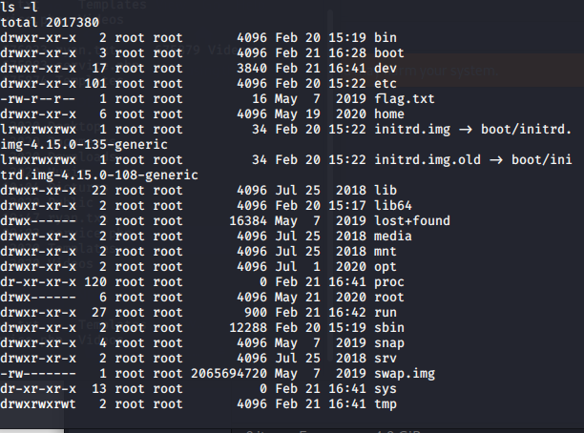

Slide 14

Blue Team
Log Analysis and Attack Characterization
‹#›

Slide 15
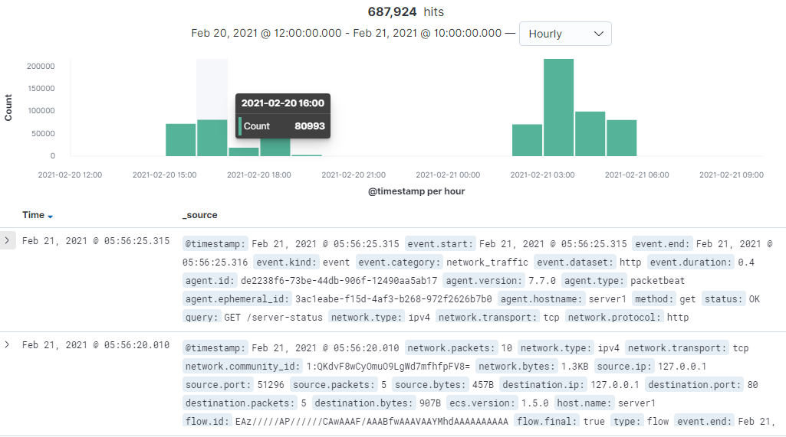
Analysis: Identifying the Port Scan
The port scan started on on Feb 21,2021 at around 3 a.m
24,369 connections occurred at the peak, the source IP was 192.168.1.90
The sudden peaks in network traffic indicate that this was a port scan.
[Insert Here]
Include a screenshot of Kibana logs depicting the port scan.

Slide 16
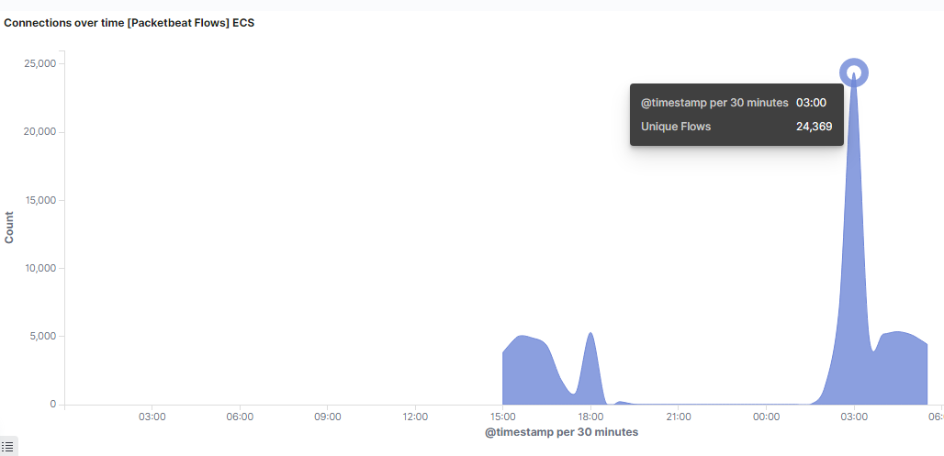

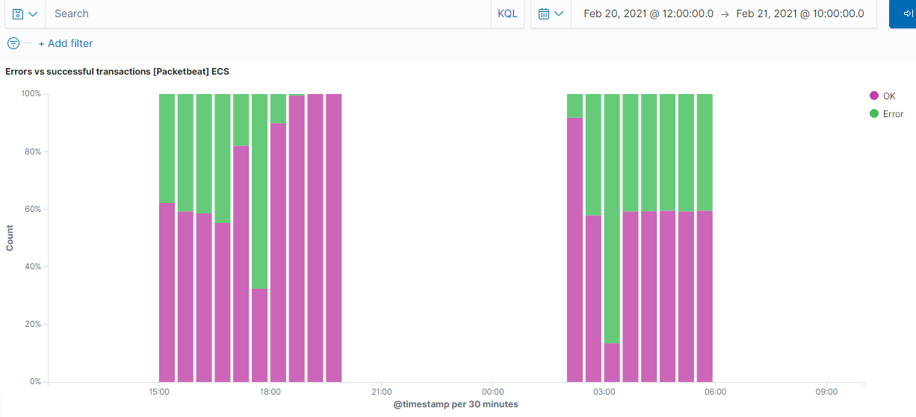
Connections over time (packetbeat flows)
Errors V Successful transactions

Slide 17

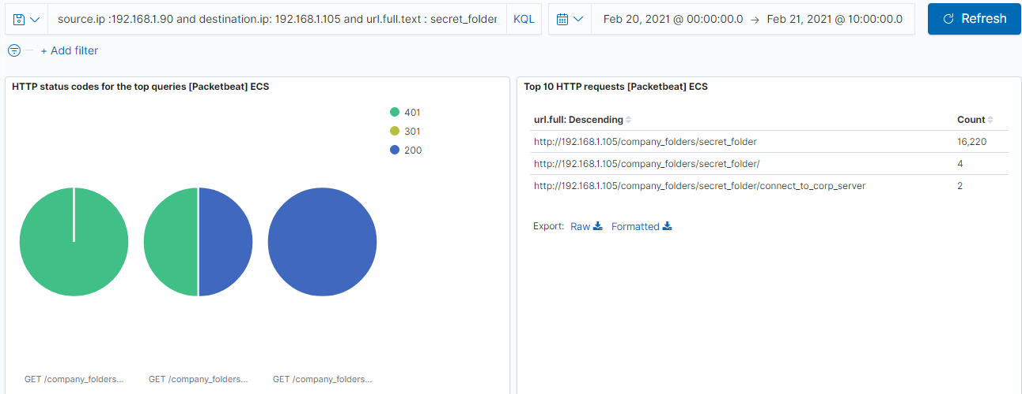
Analysis: Finding the Request for the Hidden Directory
The request started at 03.30hrs on 20th Feb 2021
As seen in the Top HTTP requests dashboard, secret_folder was accessed 16,220 times from source ip address 192.168.1.90 which is attacker’s machine.
The /secret_folder contained a hash which was used to access the system using another employee’s credentials (Ryan)
The /secret_folder also allowed to upload a payload, thus exploiting other vulnerabilities.
[Insert Here]
Include a screenshot of Kibana logs depicting the request for the hidden directory.
File name ‘connect_to_corp_server’ from secret_folder was requested 2 times. This file has instructions on how to connect to the WebDAV directory, as well the user's username and hashed password. (Ryan)

Slide 18
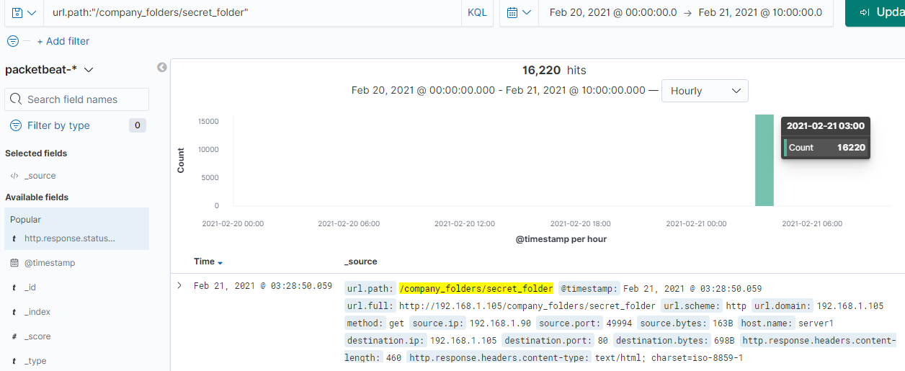
Analysis: Uncovering the Brute Force Attack
Top 10 HTTP requests [Packetbeat] ECS panel, contain evidence of large number of requests to sensitive secret_folder; but only 2 attempts were successful. This is a telltale signature of a bruteforce attack.
Searching for url.path: ”/company_folders/secret_folder” shows the results from brute-forcing tool Hydra, which is identified by user_agent.original : Mozilla/4.0 (Hydra)
[Insert Here]
Include a screenshot of Kibana logs depicting the brute force attack.

Slide 19
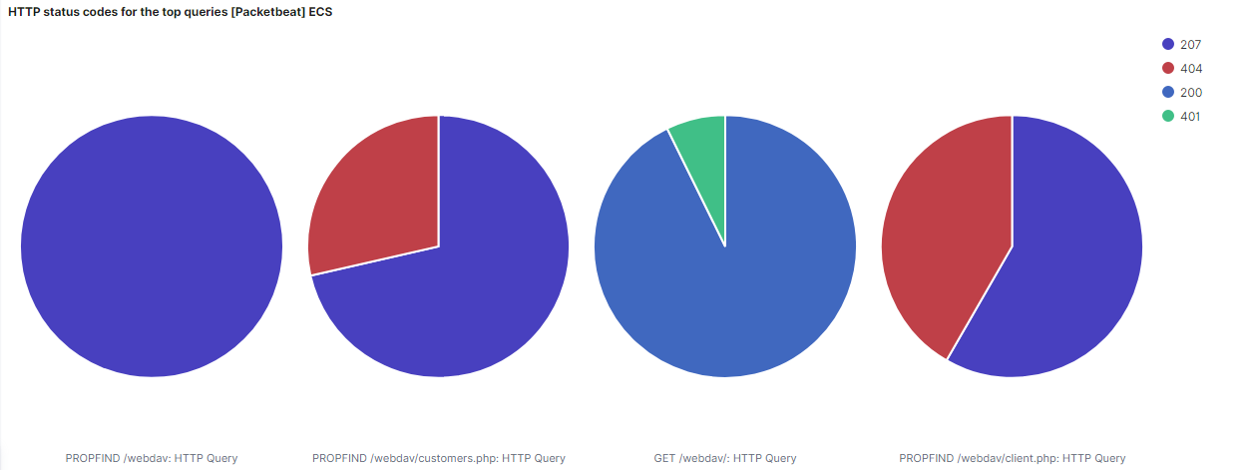
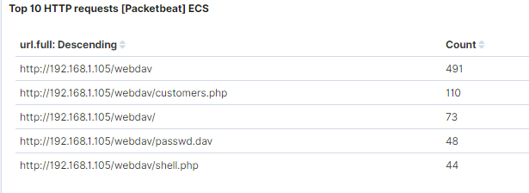
Analysis: Finding the WebDAV Connection
Top 10 HTTP requests[packetbeat] ECS panel shows that attacker was able to access password protected webdav directory 491 times.
2 different payload files were created inside webdav folder such as customers.php which was accessed 110 times and shell.php accessed 44 times & passwd.dav was accessed 48 times.
.

Slide 20
Blue Team
Proposed Alarms and Mitigation Strategies
‹#›

Slide 21
Mitigation: Blocking the Port Scan
What kind of alarm can be set to detect future port scans?
An alarm can be set if an ip address is scanning the network,and its not trusted ip address.
What threshold would you set to activate this alarm?
Alarm threshold must be more than 10 requests per second for more than 5 second.
What configurations can be set on the host to mitigate port scans?
Conduct a through scan of the ports on the network. If there are ports open that are not supposed to be then it's good to close them. Create a firewall to block incoming and outgoing traffic to unused ports.
Describe the solution. If possible, provide required command lines.
A web applications firewall should also be configured to help mitigate malicious requests before they reach applications.

Slide 22
Mitigation: Finding the Request for the Hidden Directory
What kind of alarm can be set to detect future unauthorized access?
-A trip alarm: If data is being accessed by non whitelisted IP address from the network
What threshold would you set to activate this alarm?
-If the incoming IP not whitelisted,and they are trying to access sensitive data
What configuration can be set on the host to block unwanted access?
Access to the sensitive file can be locally restricted to a specific user.
Sensitive data should be taken off public facing web servers,other either encrypted with a two-factor login
Using the command
/etc/http/conf/httpd.conf allows for
IP addresses to be allowed access or denied access

Slide 23
Mitigation: Preventing Brute Force Attacks
What kind of alarm can be set to detect future brute force attacks?
Multiple failed login attempts
401 error requests in a short period of time
200 is OK request in a short period of time from IP address outside the whitelisted
What threshold would you set to activate this alarm?
More than 100 requests per second for 5 seconds should trigger the alarm
What configuration can be set on the host to block brute force attacks?
Configuring and setting up strong passwords will mitigate brute force attacks
Account lockout policy if login attempts surpasess 2-3 tries
Two factor login

Slide 24
Mitigation: Detecting the WebDAV Connection
What kind of alarm can be set to detect future access to this directory?
Monitor access to webdev with filebeat
An alarm should be triggered on any read performed on files within webdav outside of whitelist
What threshold would you set to activate this alarm?
An alarm should go off anytime an IP address outside the whitelist tries to access webdav
What configuration can be set on the host to control access?
Administrators must install and configure filebeat on the host
Control access can also be configured in
/etc/httpd/conf/httpd.conf

Slide 25
Mitigation: Identifying Reverse Shell Uploads
What kind of alarm can be set to detect future file uploads?
Alarm should fire upon receipt of any POST request containing form or file data of disallowed file type not familiar with the network like .php
What threshold would you set to activate this alarm?
The alarm should fire whenever users upload a forbidden file
What configuration can be set on the host to block file uploads?
Filebeat should be enabled and configured
Additional configuration can be done in /etc/httpd/conf/httpd.conf

